Slide 1
Learning a Factor Model via Regularized PCA
Aviad Sela Lazar & Dor Cohen

Slide 2

Factor Model
$R_{i}=α_{i}+\sum_{\left\{j=1\right\}}^{\left\{K\right\}}{β_{ij}I_{j}+e_{i}}$
The return of a stock can be explained by some factors.
We usually assume that the number of factors is small compared to the dimensions of the problem.

Slide 3

Factor Model
$R_{i}=α_{i}+\sum_{\left\{j=1\right\}}^{\left\{K\right\}}{β_{ij}I_{j}+e_{i}}$
Clearly, We need to estimate the factors from known history of the stocks.

Slide 4

Factor Model
$R_{i}=α_{i}+\sum_{\left\{j=1\right\}}^{\left\{K\right\}}{β_{ij}I_{j}+e_{i}}$
Moreover, we need to estimate the residual risk for each stock.

Slide 5

Factor Model
$R_{i}=α_{i}+\sum_{\left\{j=1\right\}}^{\left\{K\right\}}{β_{ij}I_{j}+e_{i}}$
In the article we are going to present, this component of the model and its estimation is not discussed.

Slide 6
PCA
Principal Component Analysis (PCA) is a procedure that produces an explanation to the data at lower dimensions.
The explanation is a set of orthogonal vectors that act as axes which explain the data variance the most.

Slide 7
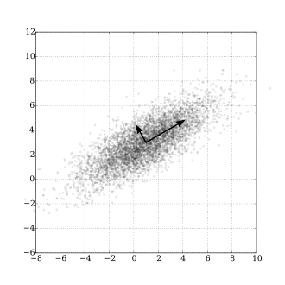
PCA
Generally, if the data points are of dimension M, we can select K < M principal components, and project the data to lower dimension, summarizing the data.

Slide 8

PCA & Factor Model
Assume we have a sample $X_{1},X_{2},…,X_{N}∼N(μ Σ_{∗})$, where $X_{i}$ represents the daily returns of $M$ stocks on day $i$.
$$Σ_{∗}=F_{∗}+{ R}_{∗} , (F_{∗}∈S_{+}^{M}, R∈D_{+}^{M})$$
$$X_{i}=F_{∗}^{\frac{1}{2}}Z_{i}+W_{i} , (Z_{i}∼N\left(μ,I\right), W_{i}∼N\left(0,R_{∗}\right))$$
Using PCA on the covariance matrix of the data, $Σ_{SAM}$, will allow us to estimate the factors and the residual risk.

Slide 9

Problem Formulation
We want to find a matrix $\hat{Σ}$ that will maximize the log-likelihood. Why not use the MLE ($Σ_{SAM}$ in our case)?
It is not very good at predicting out of sample data, unless the number of samples far exceeds the dimension of the data
We will use a different method.

Slide 10
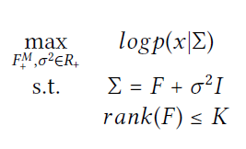

Problem Formulation URM
Note: for now, we will discuss a simpler case where the variances of the stocks are identical ($R^{∗}=σ^{2}I).$
We often believe that the data is generated by a factor model with few factors, so we will maximize the log-likelihood but constrain the rank of $F$.

Slide 11

Solution URM
The problem has closed form solution:
First, we compute an eigen-decomposition of the symmetrical matrix $Σ_{SAM}={BSB}^{T}$, where $B=\left[b_{1},…,b_{M}\right]$ and $S=diag\left(s_{1},…,s_{M}\right)$.
$$\hat{σ^{2}}=\frac{1}{M−K}\sum_{i=K+1}^{M}{s_{i}}$$
$$\hat{F}=\sum_{k=1}^{K}{\left(s_{k}−\hat{σ^{2}}\right)b_{k}b_{k}^{T}}$$
The solution can be efficiently computed with PCA!

Slide 12
Penalizing the trace
In the previous slides, the number of factors was explicitly constrained.
However, It may be beneficial to use softer regularization that will encourage a small number of factors but allow the model to learn how many are needed.
In this article, trace penalization is proposed. Intuition: the trace of a matrix is also equal to the sum of its eigenvalues.

Slide 13
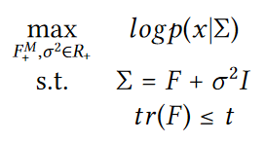
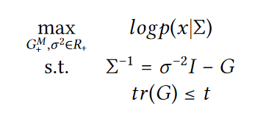

Problem Formulation UTM
Problem: not convex.
Solution:
$$define:G=σ^{−2}I−Σ^{−1}, G∈S_{+}^{M}, rank\left(G\right)=rank\left(F\right).$$

Slide 14
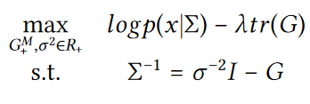

Problem Formulation UTM
The final step is to change the trace constraint into regularization:
The covariance matrix that is produced from this method is denoted: $Σ_{UTM}^{λ}$

Slide 15

Solution
Theorem:
$$Σ_{SAM} and Σ_{UTM}^{λ} share the same trace and eigenvectors. Letting$$
$$the eigenvalues of the two matrices, sorted in decreasing$$
$$order, be denoted by s_{1},…,s_{m} and h_{1},…,h_{m} respectively, we have$$
$$h_{m}=max⁡\{s_{m}−\frac{2λ}{N}, \hat{v^{−1}}\}$$
($v=σ^{−2}$)

Slide 16
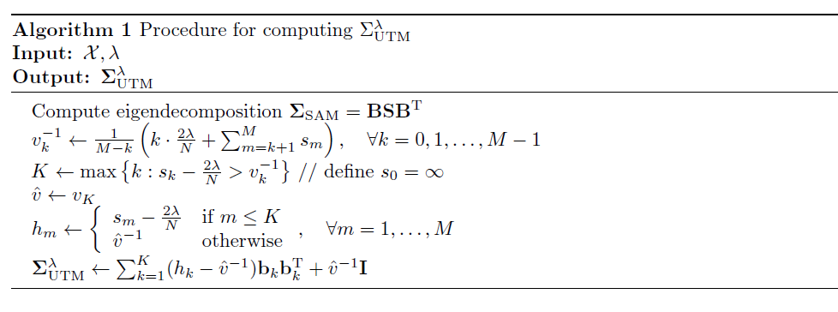
UTM: Algorithm

Slide 17
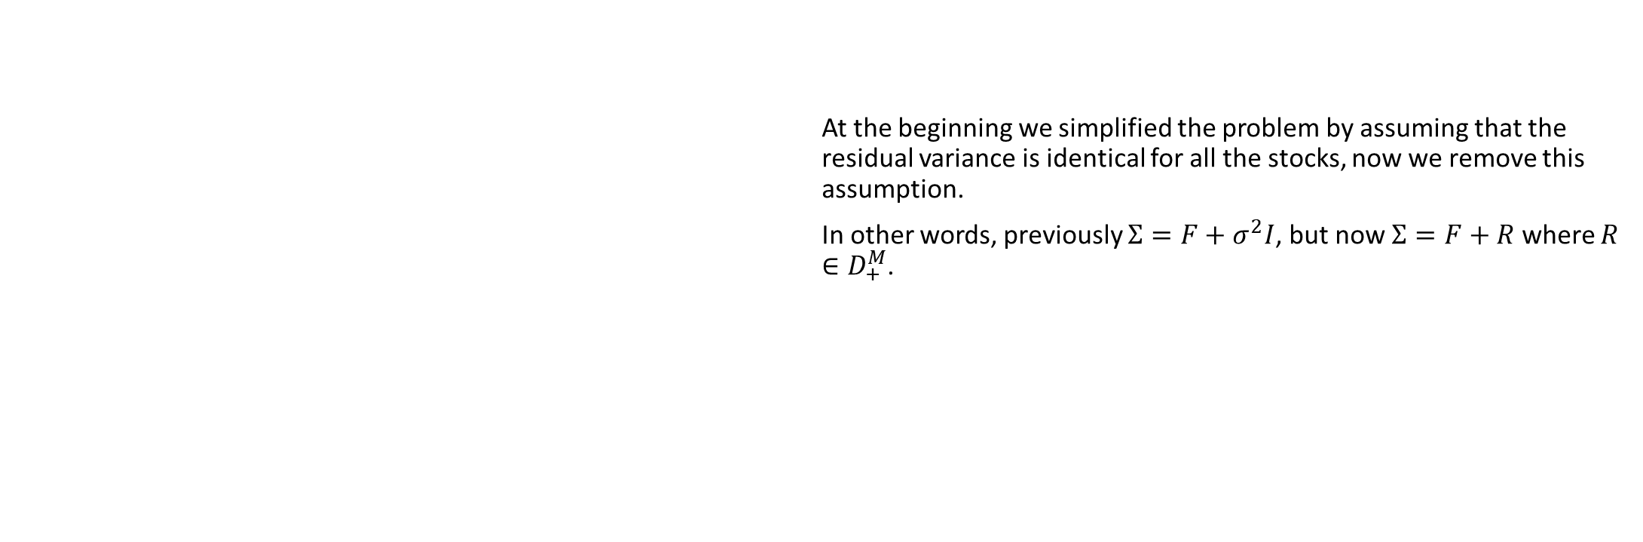
Nonuniform Residual Variance
At the beginning we simplified the problem by assuming that the residual variance is identical for all the stocks, now we remove this assumption.
In other words, previously $Σ=F+σ^{2}I$, but now $Σ=F+R$ where $R∈D_{+}^{M}$.

Slide 18
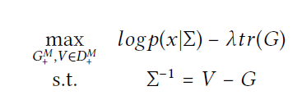
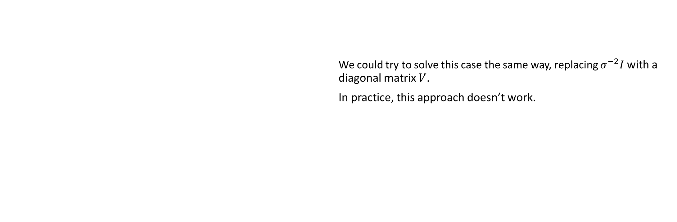
Problem Formulation STM
We could try to solve this case the same way, replacing $σ^{−2}I$ with a diagonal matrix $V$.
In practice, this approach doesn’t work.

Slide 19

Problem Formulation STM
The loss on out of sample data:
$$L\left(Σ, Σ^{∗}\right)=E\left[\log{P(x|Σ}\right)]=−\frac{1}{2}\left(Mlog\left(2π\right)+\log\left(\det\left(Σ\right)\right)+tr\left(Σ^{−1}Σ_{∗}\right)\right)$$
Given some $T∈D_{+}^{M}$ we have that:
$$L\left(TΣT^{T},TΣ_{∗}T^{T}\right)=L\left(Σ,Σ_{∗}\right)−log⁡(\det\left(T\right))$$
$$TΣT^{T}=TFT^{T}+TRT^{T}$$
If ${∀i, T}_{ii} =α\frac{1}{√R_{ii}}$ then $TRT^{T}=αI.$
We can form a covariance matrix where the residual variance is identical.

Slide 20
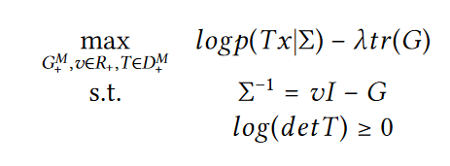

Problem Formulation STM
Finally, we get this optimization problem:
The covariance matrix that is produced from this method is denoted: $Σ_{STM}^{λ}$

Slide 21
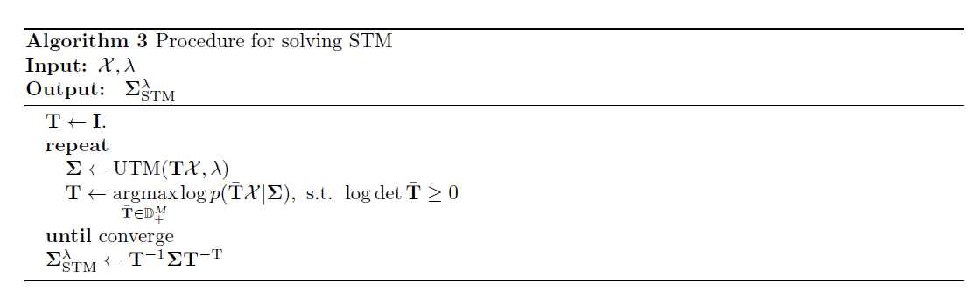
STM: Algorithm

